Slide 1


Open Banking Safety and Fraud Mitigation
By
- Balakrishna Addagada
- Vasudeva Reddy

Slide 2

Introduction
Open banking integrates financial institutions with third-party apps to enhance consumer experiences. However, this innovation introduces potential risks, making safety and fraud mitigation critical priorities
Abstract: This project leverages machine learning to identify anomalies in open banking systems, focusing on fraud prevention strategies. The goal is to enhance fraud detection, improve security, and strengthen consumer trust by implementing robust anti-fraud measures and best practices.

Slide 3
Business Need
API Integration: Improve operational efficiency through seamless integration.
User Experience: Enhance consumer interactions while maintaining trust.
Credibility: Protect the authenticity and reliability of financial services.

Slide 4
Problem Statement
Objective: Ensure secure open banking transactions by reducing fraud risks and building user confidence.
Approach:
Utilize advanced anomaly detection techniques.
Provide real-time notifications and comprehensive reporting.
Design user-friendly dashboards for transparency.
Benefits:
Proactive fraud mitigation.
Improved consumer trust.
Transparent user experience.

Slide 5
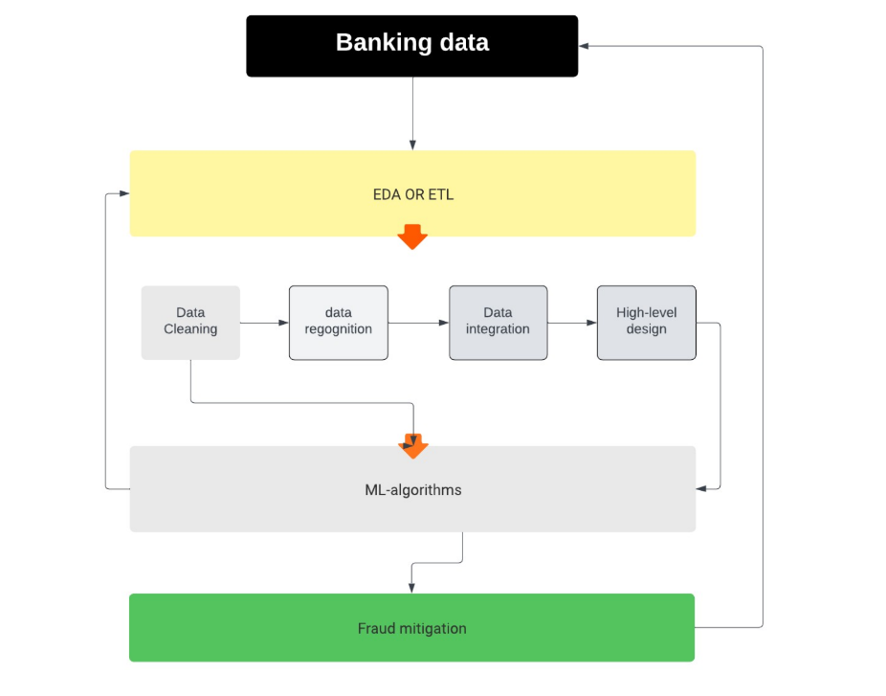
High Level Architecture Diagram

Slide 6
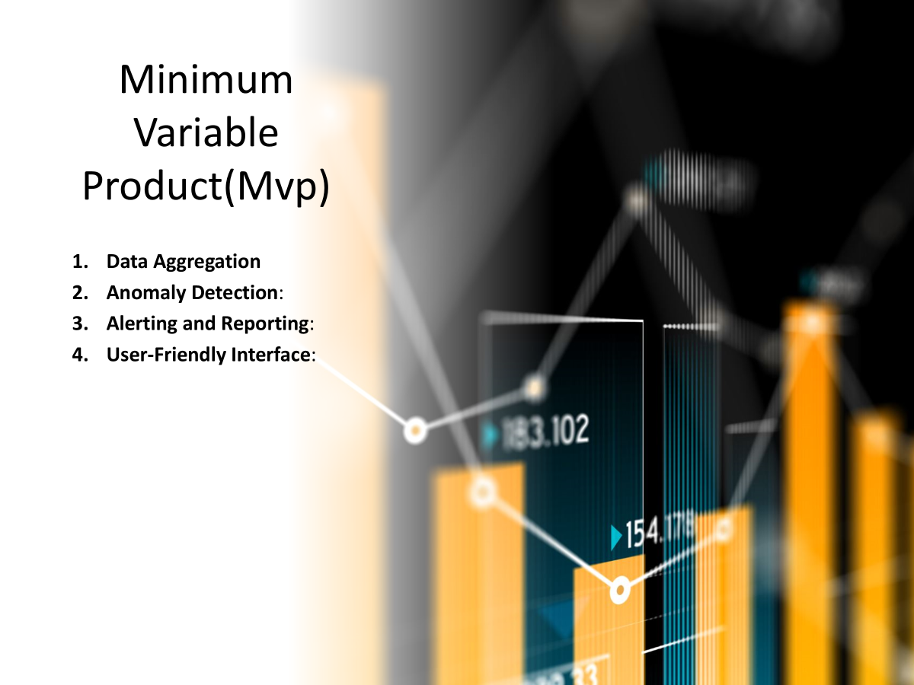

Slide 7
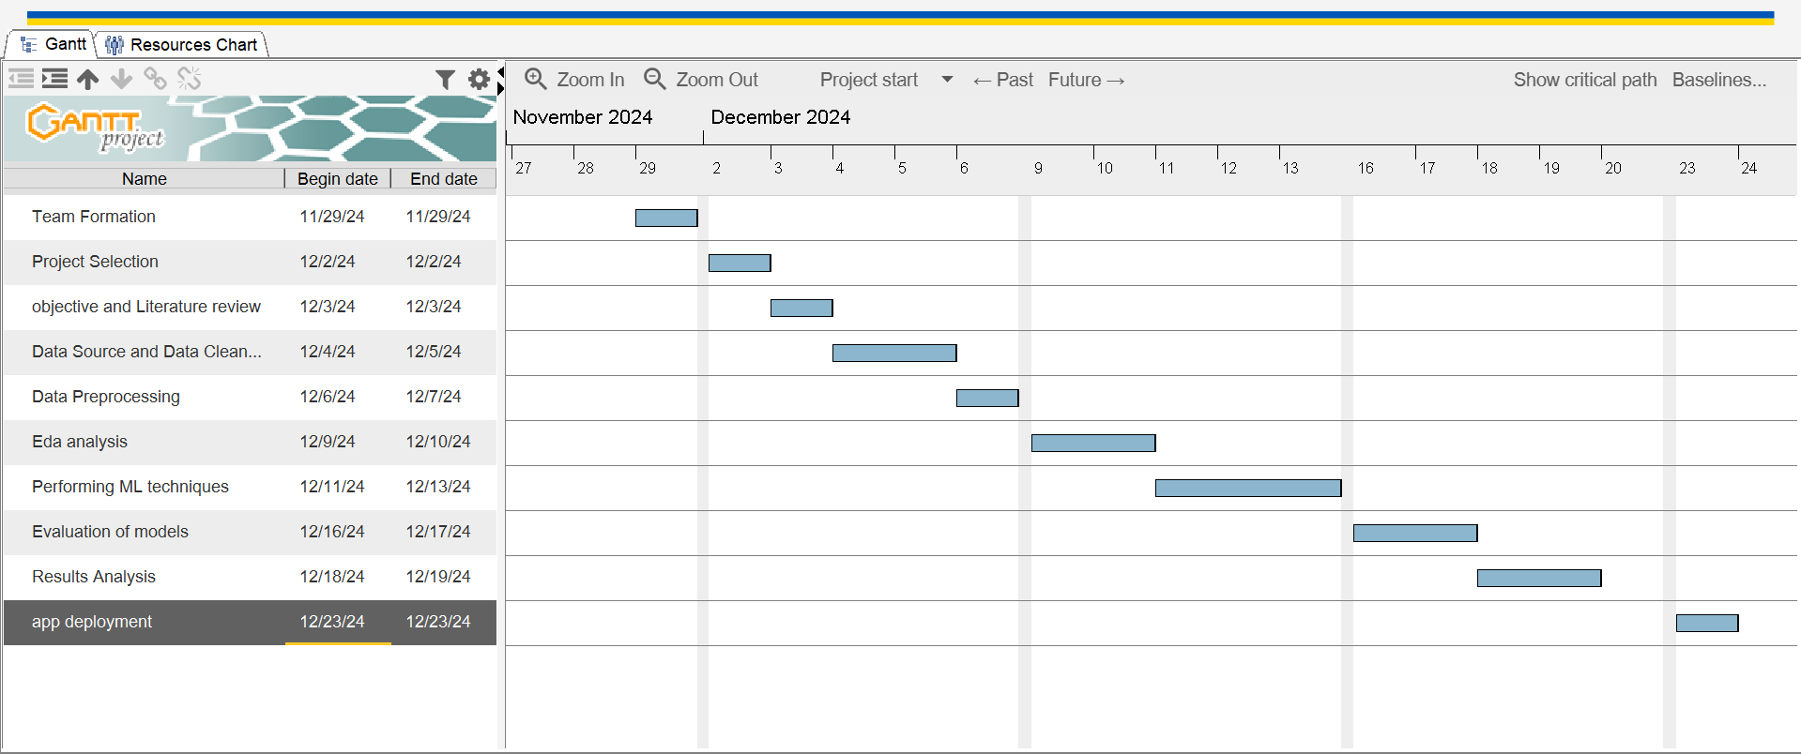
Gantt Chart

Slide 8
References
Ali, A., Razak, S. A., Othman, S. H., Eisa, T. a. E., Al-Dhaqm, A., Nasser, M., Elhassan, T., Elshafie, H., & Saif, A. (2022). Financial Fraud Detection Based on Machine Learning: A Systematic Literature review. Applied Sciences, 12(19), 9637. https://doi.org/10.3390/app12199637
Boulieris, P., Pavlopoulos, J., Xenos, A., & Vassalos, V. (2023). Fraud detection with natural language processing. Machine Learning. https://doi.org/10.1007/s10994-023-06354-5
Afriyie, J. K., Tawiah, K., Pels, W. A., Addai-Henne, S., Dwamena, H. A., Owiredu, E. O., Ayeh, S. A., & Eshun, J. (2023). A supervised machine learning algorithm for detecting and predicting fraud in credit card transactions. Decision Analytics Journal, 6, 100163. https://doi.org/10.1016/j.dajour.2023.100163
Jendruszak, B., & Jendruszak, B. (2023, April 11). Risks of open banking Fraud & How to protect yourself in 2023. SEON. https://seon.io/resources/openbanking-risk-and-fraud
Mytnyk, B., Tkachyk, O., Shakhovska, N., Fedushko, S., & Syerov, Y. (2023). Application of artificial intelligence for fraudulent banking operations recognition. Big Data and Cognitive Computing, 7(2), 93. https://doi.org/10.3390/bdcc7020093
Fraud and financial crimes: Regulatory challenges. (n.d.). KPMG https://kpmg.com/us/en/articles/2022/ten-key-regulatory-challenges-2022-fraud-financial-crimes.html
https://ieeexplore.ieee.org/document/9087123/citations#citations
https://link.springer.com/chapter/10.1007/978-981-97-6726-7_41
https://ieeexplore.ieee.org/document/10226912

Slide 9
Data Source
Deposits at Financial Institutions (Bank statement data) - Open Government Portal
https://open.canada.ca/data/en/dataset/2061075a-55fe-47a5-be2f-984f12fc0d40

Slide 10
Fraud Mitigation Strategies
• Fraud Detection and Prevention Tools
• Real-Time Monitoring Systems
• Collaboration Between Banks and FinTechs

